Slide 1
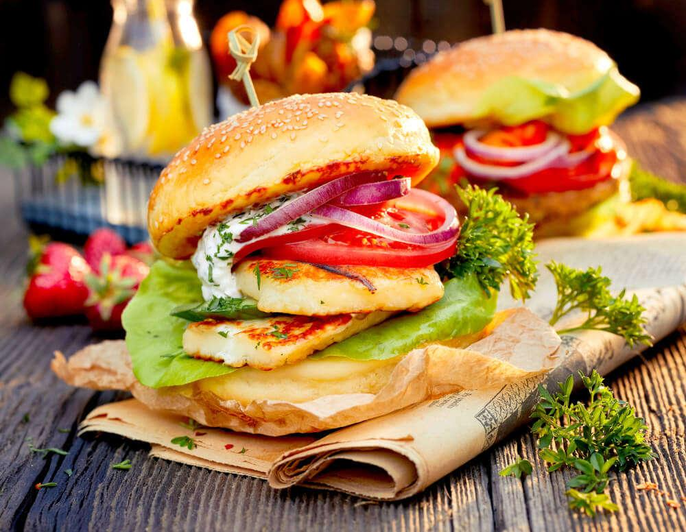



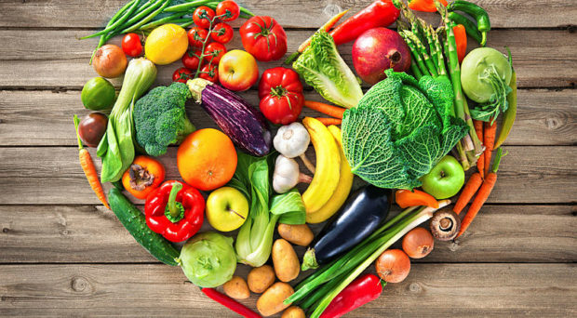
What is in our food?

Slide 2
Learning outcomes
2.7 Identify the chemical elements present in carbohydrates, proteins and lipids (fats and oils)
2.8 describe the structure of carbohydrates, proteins and lipids as large molecules made up from smaller basic units: starch and glycogen from simple sugars, protein from amino acids and lipid from fatty acids and glycerol
2.9 Practical: Investigate food samples for the presence of glucose, starch, protein and fat

Slide 3
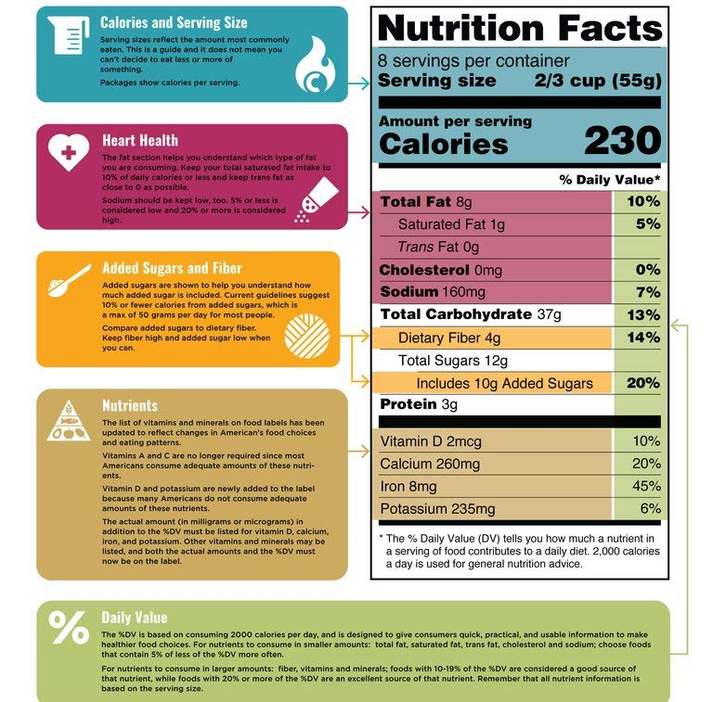
Why might we need to know what nutrients are in foods?
So you can make sure you are eating foods which form a balanced diet.
Allergies – so you can avoid certain foods.
Some people may need to monitor or restrict their diet – for example if they have diabetes.

Slide 4

Carbohydrates
There are two types of carbohydrates:
Simple carbohydrates
  E.g. sugar
Complex carbohydrates
  E.g. starch

Slide 5
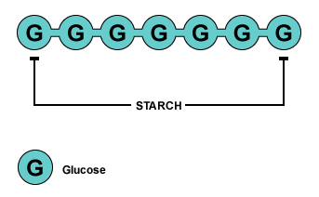
What is starch?
Starch is a carbohydrate. Carbohydrates are made of sugar! Starch is made of glucose bonded to glucose in a long chain (polymer).
Carbohydrate
Question: State 2 foods which are high in carbohydrates.
Challenge: What is glucose needed for in the body?

Slide 6
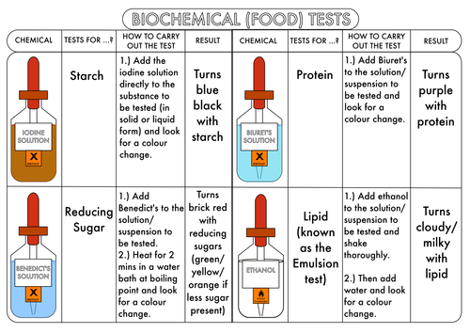
How can we tell if food contains starch?

Slide 7
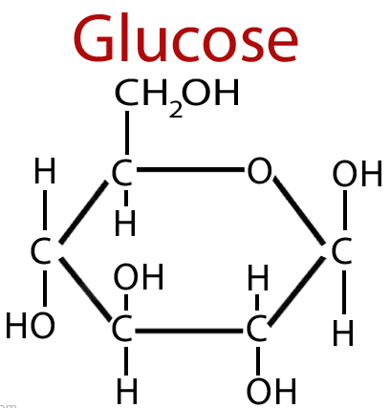
What is sugar?
There are many different types of sugar. We are going to focus on glucose.
Glucose has the chemical formula C₆H₁₂O_{6.}
How is sugar made?
Name the elements which make glucose and state how many of each there are.
What is made when lots of glucose molecules bond together into a chain?

Slide 8
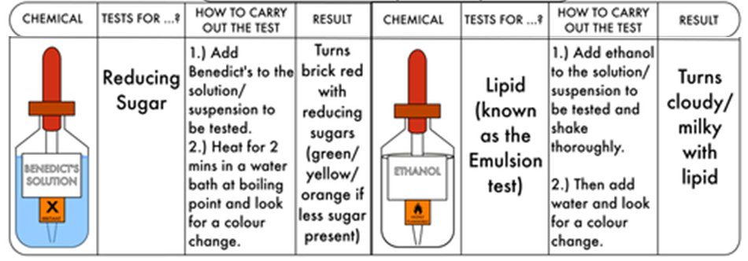
How can we tell if food contains sugar?

Slide 9
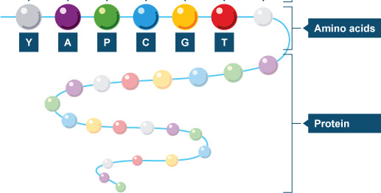
What is protein?
Protein is made of amino acids bonded together in a long chain (polymer). There are 21 different types of amino acids which form different types of proteins depending on their order in the chain.
Protein
Question: State 2 foods which are high in protein.
Challenge: What is protein needed for in the body?

Slide 10
How can we tell if food contains protein?

Slide 11
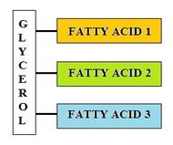
What are lipids?
Lipids are needed as a store of energy and for insulation. Lipids are made of one glycerol joined to 3 fatty acids.
Lipid
Question: State 2 foods which are high in lipids.
Challenge: What are lipids needed for in the body?

Slide 12
How can we tell if food contains lipids?

Slide 13
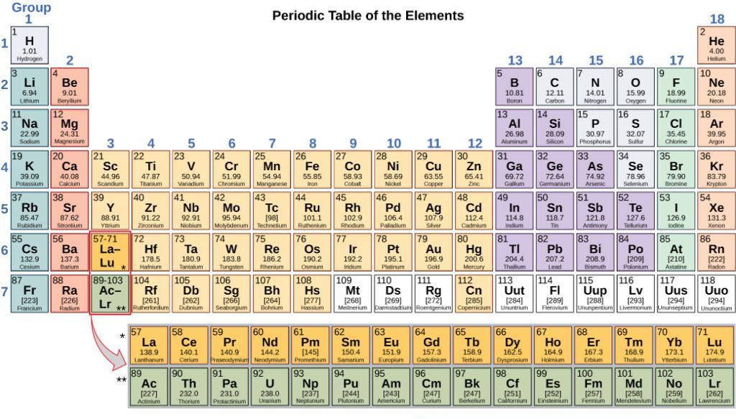
What elements can be found in
Carbohydrates?
Fats?
Proteins?

Slide 14
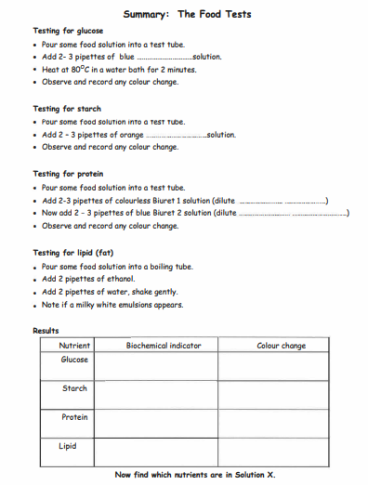
Follow the method to test for each nutrient.
Complete the worksheet

Slide 15
Can we tell how much of each food group are present?
These food tests are qualitative not quantitative. This means they tell us if the sugar or lipids are present (yes or no) but do not tell us how much there is (e.g 10g).
Qualitative data is NOT measured by a number, it is descriptive data which is categorical/n.
Quantitative data IS measured by a number, it tells us a quantity.
Some may argue that the test for sugar is quantitative. Explain why they might think that.

Slide 16
Whiteboard Quiz
Name the elements that makes carbohydrates.
Name the monomers that makes proteins.
What do we use to test for lipids?
What do we use to test for sugar?
What colour does Benedict’s turn in the presence of sugar?
What colour does iodine solution turn in the presence of starch?
True or False? A qualitative test tells us how much of a substance is present.

Slide 17
Plenary
Mrs Wightman is baking some gingerbread biscuits for the Science teachers. Mr Grey is trying to control his calorie intake but gain muscle so he wants food which contains protein but not sugar or starch.
Explain how he could test Mrs Wightman’s biscuits to see what nutrients they contain.

